Slide 1
Chapter 1 Introduction to Java

Slide 2
OBJECTIVES
In this chapter you will learn:
History of Java
Features of Java
Three edition for Java SDK
A typical Java development environment
To test-drive a Java application using the command line

Slide 3
1.1 History of Java
1991
Sun Microsystems funded an internal corporate research project led by James Gosling
2009
Sun Microsystems was acquired by Oracle

Slide 4
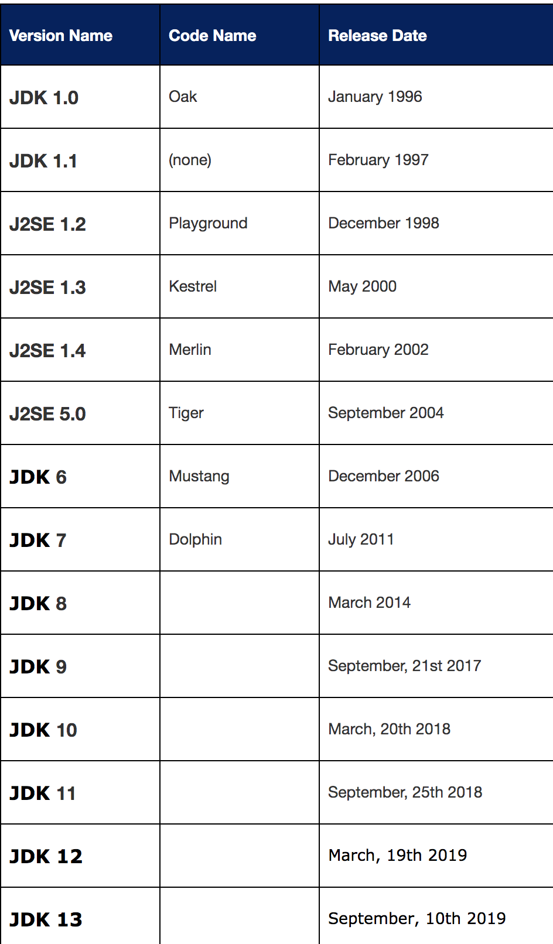
Java SE versions history

Slide 5
1.2 Features of Java
simple
object-oriented
distributed
Interpreted(解析性的）
Robust(强壮的）
compile-time error checking/ not support memory pointers / automatic garbage collection
Notes:
Simple: It eliminates several language features available in C/C++ that are associated with poor programming practices or rarely used: goto statements, header files, structures, operator overloading, multiple inheritance and pointers.

Slide 6
1.2 Features of Java (Cont.)
secure
architecture neutral(体系结构中立）
portable
high performance
multithreaded
dynamic language
Notes:
architecture neutral
With JVM, Java applications are able to run on most platforms.
dynamic language
Java supports dynamic loading of classes (a.k.a. “load on demand”), dynamic compilation, and automatic memory management (garbage collection).

Slide 7
1.3 Three edition for Java SDK
Java SDK Standard Edition（J2SE)
contains the basic core Java classes.
Java SDK Micro Edition (J2ME)
for developers that code to portable devices, such as a palm pilot or a cellular phone.
Java SDK Enterprise Edition (J2EE)
contains classes that go above and beyond J2SE
Notes:
architecture neutral
With JVM, Java applications are able to run on most platforms.
dynamic language
Java supports dynamic loading of classes (a.k.a. “load on demand”), dynamic compilation, and automatic memory management (garbage collection).

Slide 8
1.4 Introduction to Object-Oriented Technology
Object
Methods and classes
Instance
Reuse
Messages and methods calls
Attributes and instance variables
Encapsulation
Inheritance
Polymorphism
OOAD

Slide 9
1.5 Java and a Typical Java Development Environment (Cont.)
Java Class Libraries
Rich collections of existing classes and methods
Also known as the Java APIs (Application Programming Interfaces).

Slide 10
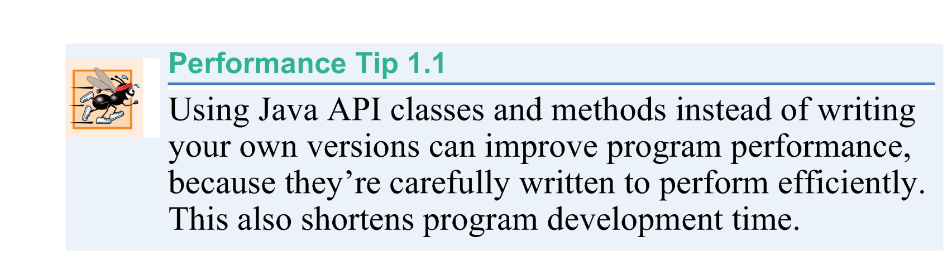

Slide 11
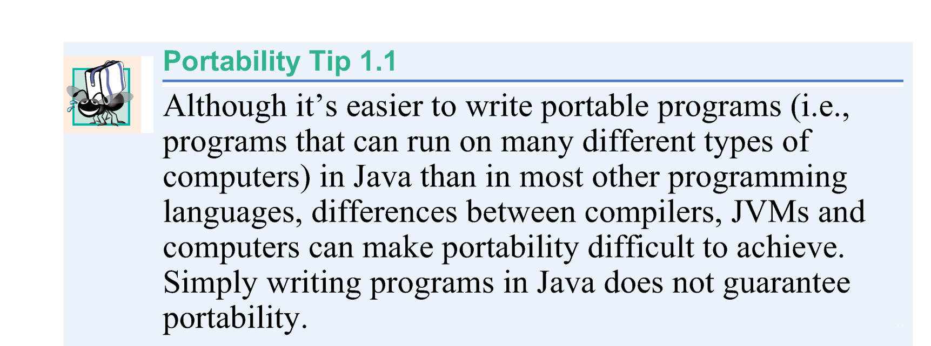

Slide 12
1.5 Java and a Typical Java Development Environment (Cont.)
Java programs normally go through five phases
edit
compile
load
verify
execute

Slide 13
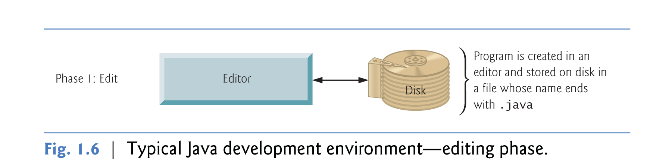
1.5 Java and a Typical Java Development Environment (Cont.)
Phase 1 consists of editing a file with an editor program
Type a Java program (source code) using the editor.

Slide 14
1.5 Java and a Typical Java Development Environment (Cont.)
Linux editors: vi and emacs.
Windows editors:
Notepad
EditPlus (www.editplus.com)
TextPad (www.textpad.com)
jEdit (www.jedit.org).

Slide 15
1.5 Java and a Typical Java Development Environment (Cont.)
Popular Integrated development environments（IDEs）
Eclipse (www.eclipse.org)
NetBeans (www.netbeans.org).
jGRASP™ IDE (www.jgrasp.org)
DrJava IDE (www.drjava.org/download.shtml)
BlueJ IDE (www.bluej.org/)
TextPad® Text Editor for Windows® (www.textpad.com/)

Slide 16
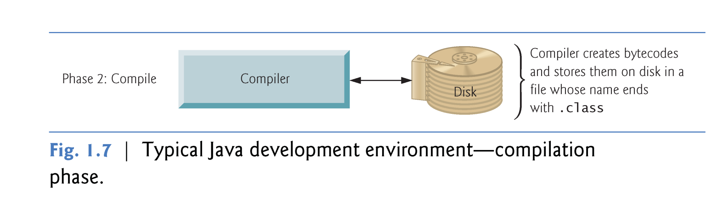
1.5 Java and a Typical Java Development Environment (Cont.)
Phase 2: Compiling a Java Program into Bytecodes
Use the command javac (the Java compiler) to compile a program
javac Welcome.java

Slide 17
1.5 Java and a Typical Java Development Environment (Cont.)
The JVM is invoked by the java command.
java Welcome

Slide 18
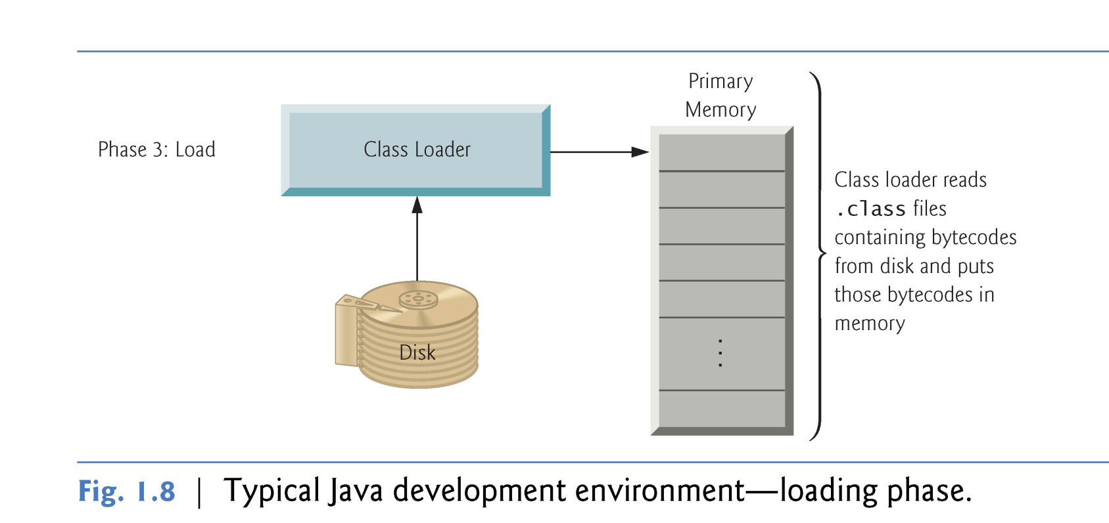
1.5 Java and a Typical Java Development Environment (Cont.)
Phase 3: Loading a Program into Memory

Slide 19
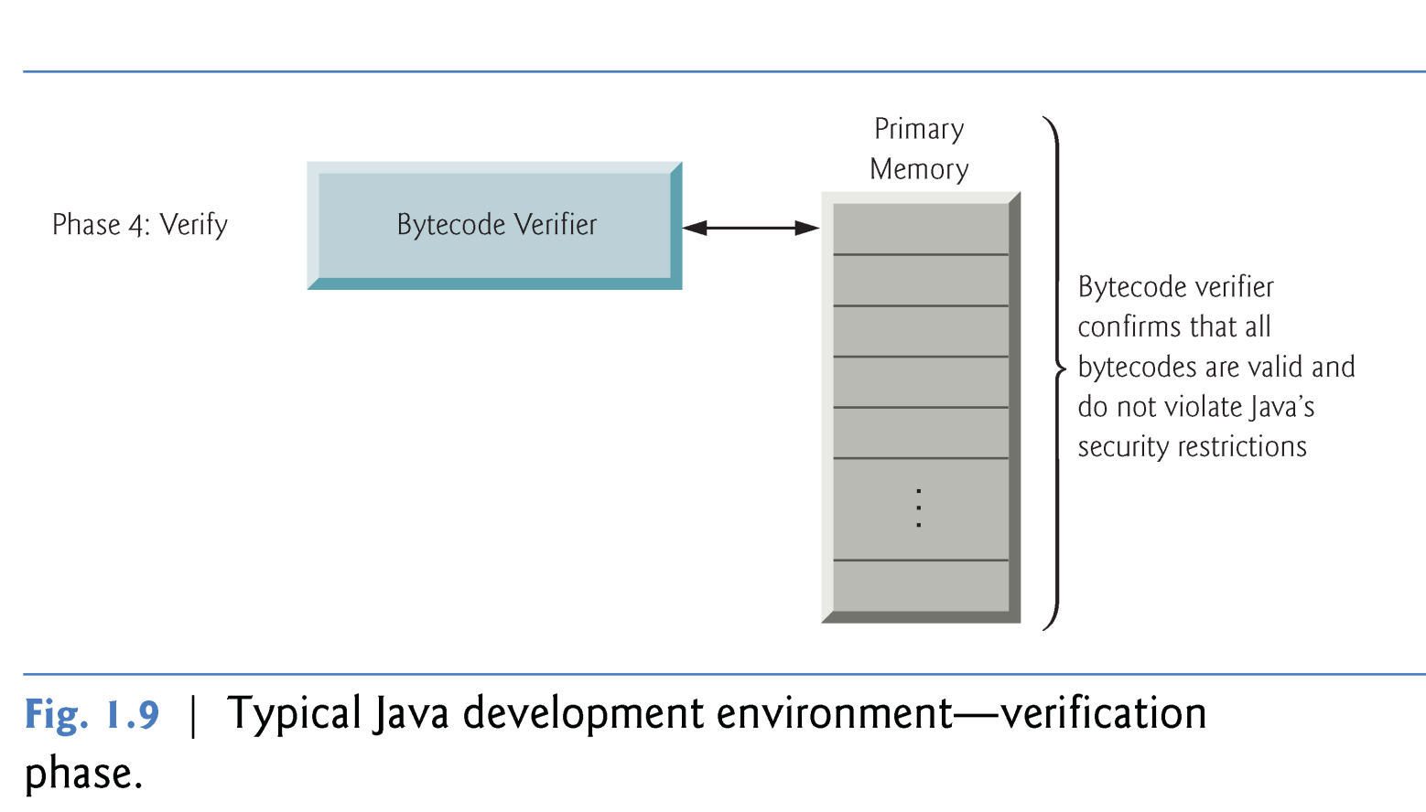
1.5 Java and a Typical Java Development Environment (Cont.)
Phase 4: Bytecode Verification
As the classes are loaded, the bytecode verifier examines their bytecodes
Ensures that they’re valid and do not violate Java’s security restrictions.

Slide 20
1.5 Java and a Typical Java Development Environment (Cont.)
Phase 5: Execution
The JVM executes the program’s bytecodes.
JVMs typically execute bytecodes using a combination of interpretation(解释) and so-called just-in-time (JIT) compilation.
Analyzes the bytecodes as they’re interpreted
A just-in-time (JIT) compiler—known as the Java HotSpot compiler—translates the bytecodes into the underlying computer’s machine language.

Slide 21
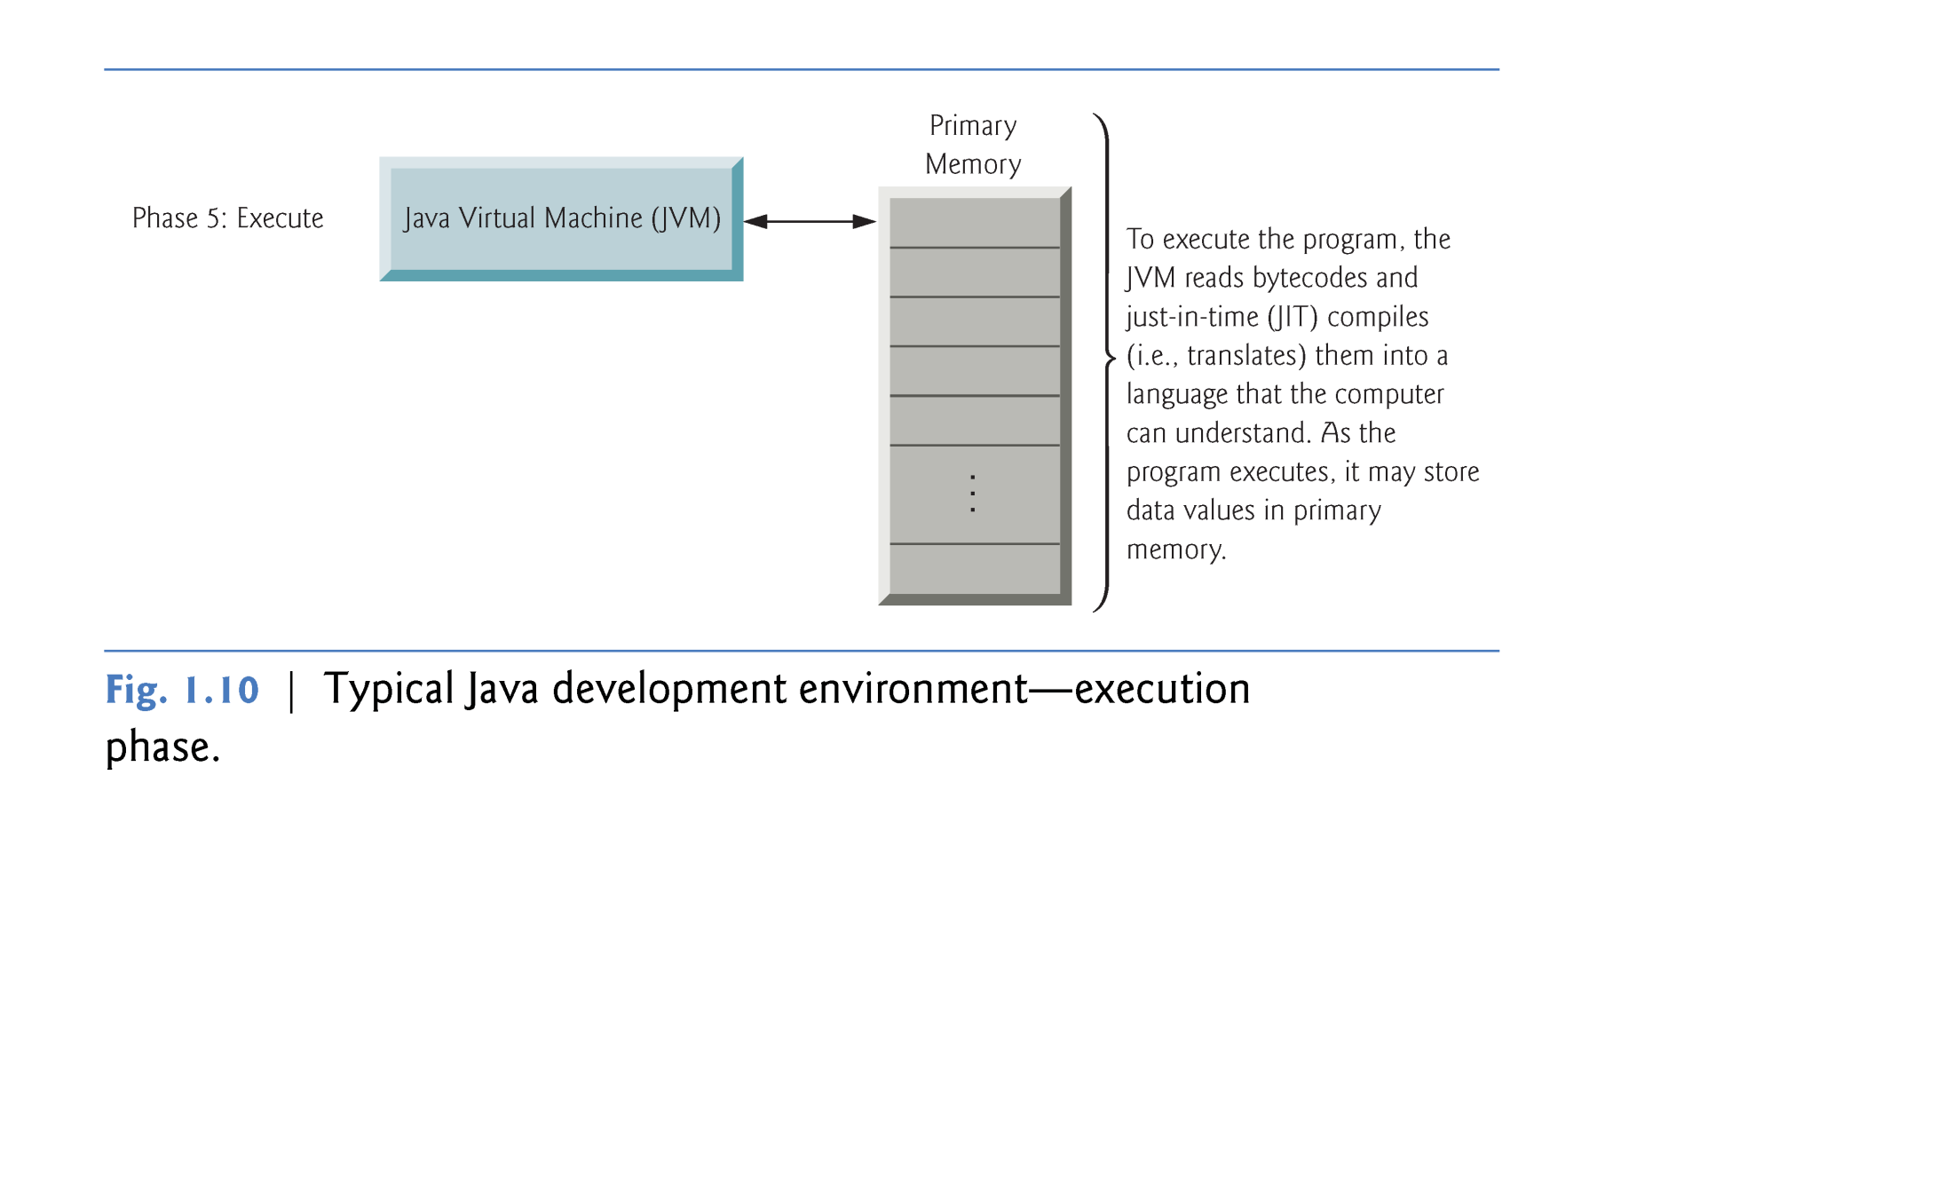

Slide 22
1.6 Test-Driving a Java Application
Checking your setup. Read the Before You Begin section of the book to confirm that you’ve set up Java properly on your computer and that you’ve copied the book’s examples to your hard drive.

Slide 23
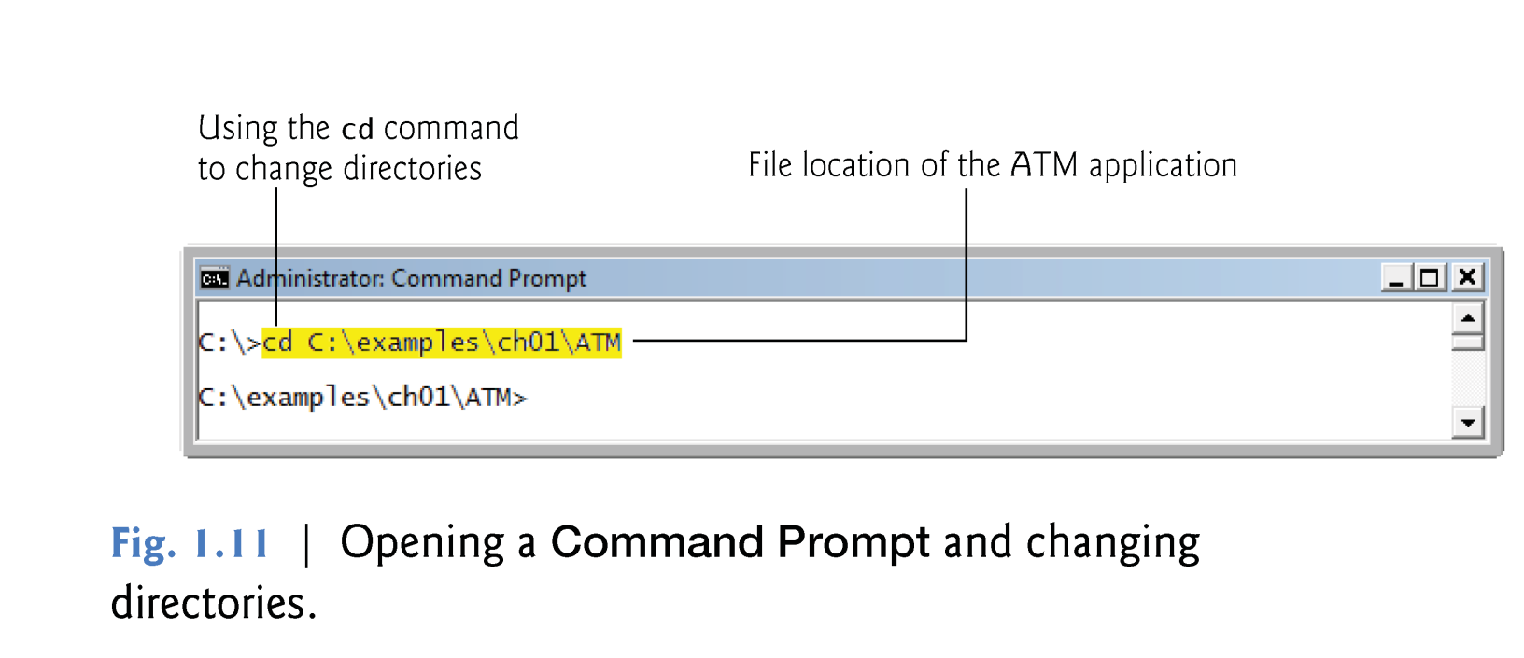
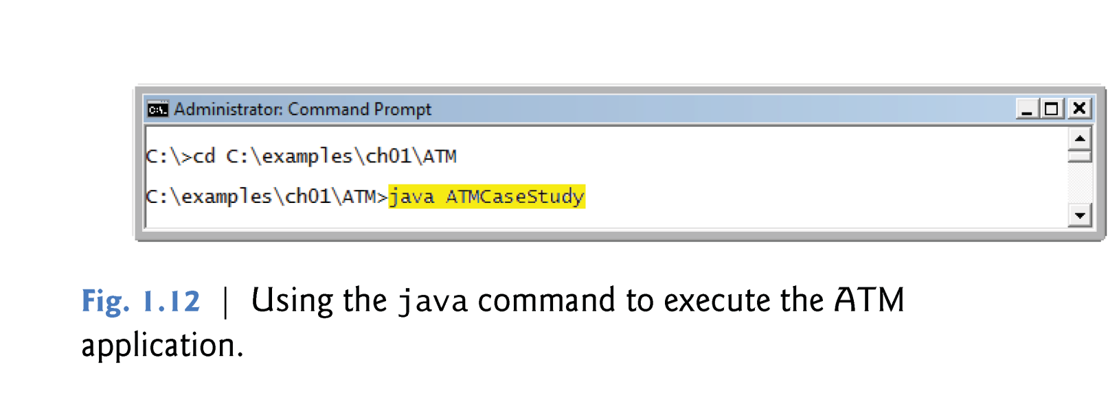

Slide 24
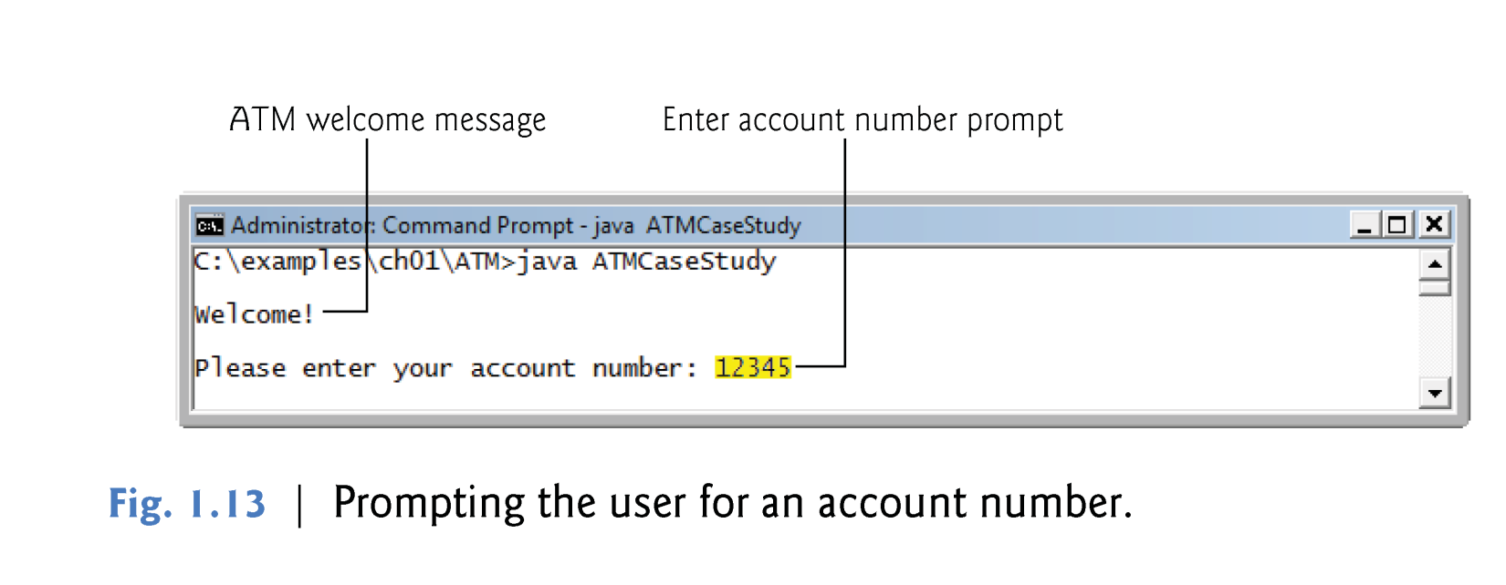
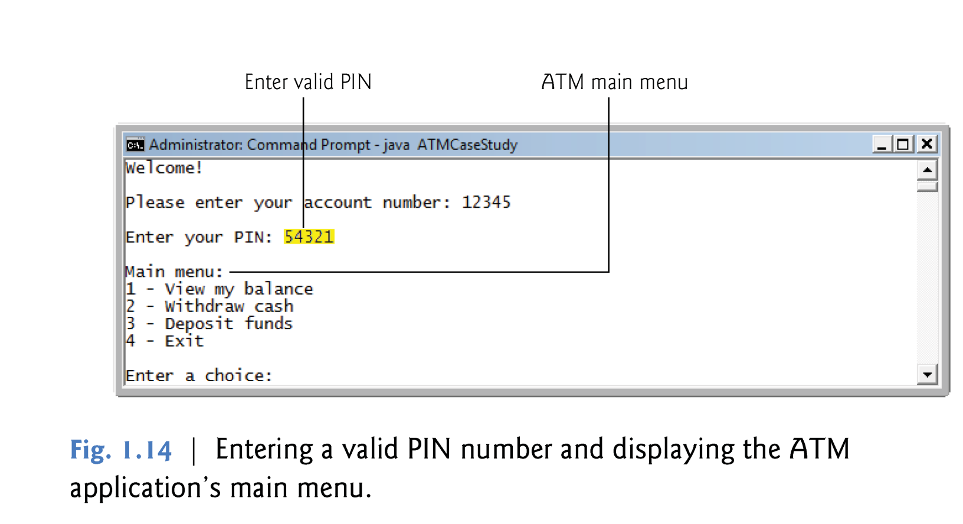

Slide 25
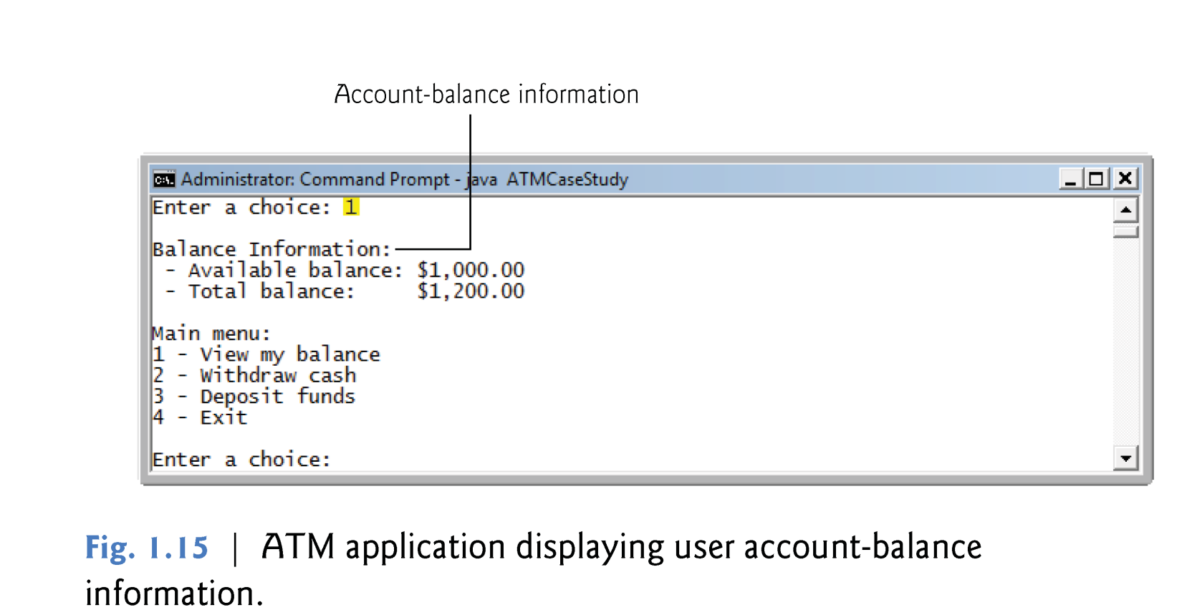
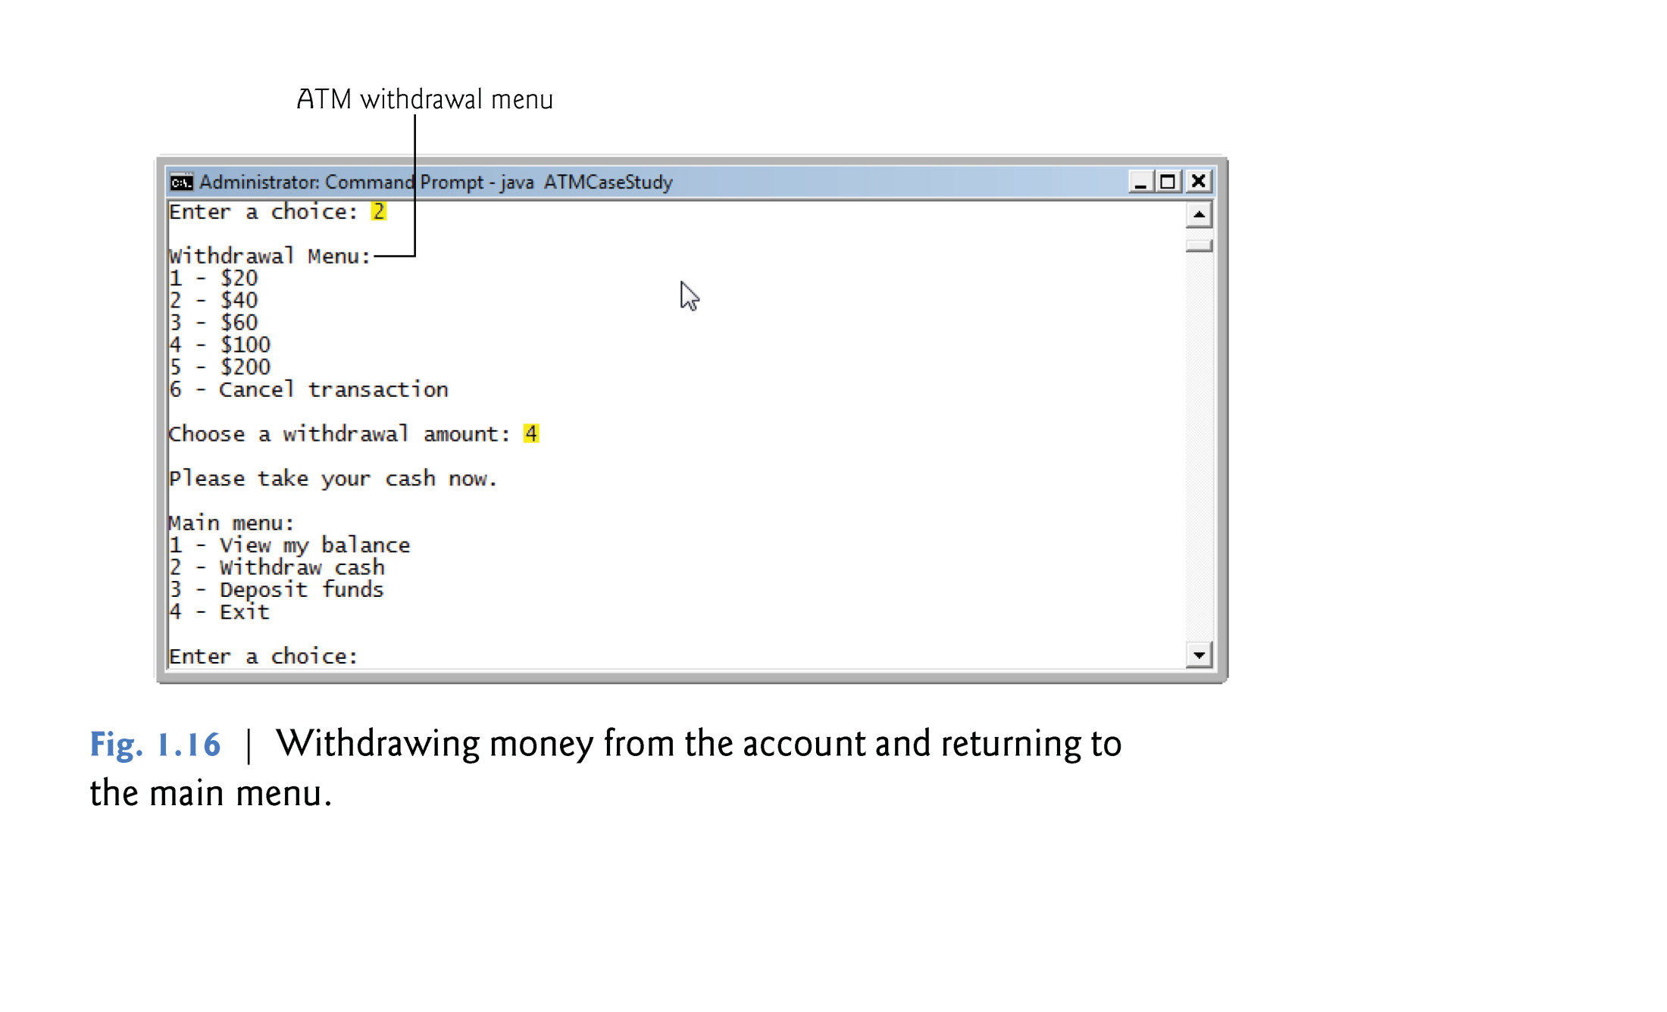

Slide 26
